Slide 1


Software Process Improvement –SEPI-471
INTRODUCTION
Dr. Nargis Fatima
ASSISTANT PROFESSOR
Department of software engineering , FEc
National University Of Modern Languages H-9 Islamabad

Slide 2
Agenda
Course Introduction
Software Process
Software Process Improvement
Motivation for Software Process Improvement
Relationship between Product Quality and Process
History of Software Process Improvement
Product Quality and Process Maturity
SEPI-471
National University Of Modern Languages H-9 Islamabad

Slide 3
Course Introduction
Course Break Down
Course Learning Outcome
Course Assessment
Course Content
Course Code SEPI-471
National University Of Modern Languages H-9 Islamabad

Slide 4
Course Learning Outcomes
CLOs | Description | Domain | Taxonomy level | PLOs | Assessment Artifact
CLO1 | Explain fundamental concepts of software processes improvement to improve the processes in software development organizations | Cognitive | 2 | 2 | Q1, A1, Midterm
CLO2 | Demonstrate software process improvement models for appropriate implementation in software development organizations. | Cognitive | 2 | 2 | Q2, A2, Midterm, Final Term
CLO3 | Apply software process improvement approaches and models for problem analysis and process improvement. | Cognitive | 3 | 3 | Q3, A3, Final Term, Project/Presentation
National University Of Modern Languages H-9 Islamabad

Slide 5
Course Assessment
Evaluation Methods | Weight (%)
Quizzes | 10
Assignments | 10
Presentation/Project | 5
Midterm | 25
Final Term | 50
Total | 100
National University Of Modern Languages H-9 Islamabad

Slide 6
Course Content and Reference Books
Course Outline
National University Of Modern Languages H-9 Islamabad

Slide 7
What is software process
A software development process is the process used by software engineers to design and develop computer software.
It may be an undocumented ad hoc process or it may be a standardized and documented process used by various teams on similar projects.
It acts as the glue that ties people, technology, and procedures coherently together
National University Of Modern Languages H-9 Islamabad

Slide 8
What is software process?
The software development processes includes a set of processes to determine
Requirements
Design
Development
Verification
Maintenance
National University Of Modern Languages H-9 Islamabad

Slide 9
What is software process?
A software process is a set of
Activities
Methods
Practices
to develop and maintain software as well as the associated work products.
National University Of Modern Languages H-9 Islamabad

Slide 10
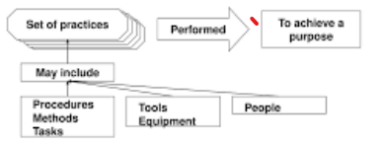
What is software process?
A process is a set of practices or tasks performed to achieve a given purpose. It may include tools, methods, material, and people.
National University Of Modern Languages H-9 Islamabad

Slide 11
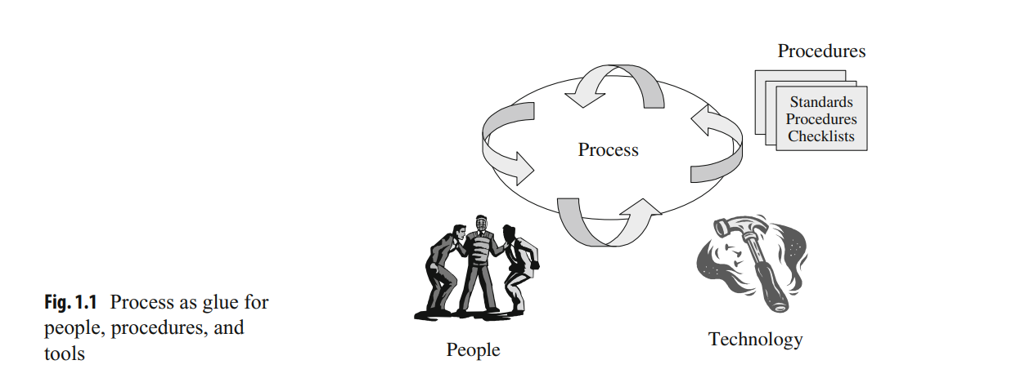
What is software process?
The process is an abstraction of the work done in the organization and is seen as the glue that ties people, procedures, and tools together
National University Of Modern Languages H-9 Islamabad

Slide 12
Software Process
Software Process
A software process is the set of activities and associated outcome that produce a software product.
Improvement
To make something better.
National University Of Modern Languages H-9 Islamabad

Slide 13
Software process and Process Improvement
An organization consists of a set of various processes for doing its work, and process improvement is used to improve these processes to effectively meet business goals
National University Of Modern Languages H-9 Islamabad

Slide 14
Software Process Improvement
Process improvement
“a proactive task”
Identifying a process is in need of reform or improvement.
Analyzing this process to see what issue needs addressing
Changing key aspects, steps or tasks in a process to improve its overall performance.
National University Of Modern Languages H-9 Islamabad

Slide 15
Software Process Improvement
Process improvement is all about
moving something from one state to another, with that shift taking it from a state that is not operating as effectively as it could to one that is.
removing waste, making processes and the people who work within them more productive and efficient.
National University Of Modern Languages H-9 Islamabad

Slide 16
Software Process Improvement
It can be both a continual effort, something where you make amendments and improvements regularly.
It can also be a one off exercise, where you conduct a review, deliver recommendations and work on them.
National University Of Modern Languages H-9 Islamabad

Slide 17
What Is Software Process Improvement?
Software process improvement is concerned
-to improve the processes within the organization
-to ensure that they meet business goals more effectively
For example, the goal may be to improve process performance to allow projects to be delivered faster and with higher quality
National University Of Modern Languages H-9 Islamabad

Slide 18
SOFTWARE PROCESS IMPROVEMENT
There are international standards and models available to support software process improvement
CMMI Model :Developed by SEI institute and includes best practices for processes in software and system engineering
ISO 9001 Standard: is a quality management system that may be employed in hardware or software development companies
ISO 15504 standard: is an international standard for software process improvement and process assessment.
National University Of Modern Languages H-9 Islamabad

Slide 19
Core of SOFTWARE PROCESS IMPROVEMENT.
Software process improvement is concerned with defining the right processes and following them consistently.
It involves training all staff on the new processes, refining the processes, and continuously improving the processes

Slide 20

Motivation for Software Process Improvement
Impact of New Technologies on Businesses and Daily Life
Widespread Use of Software in Modern Systems
Importance of Safe and Reliable Software Solutions

Slide 21
Motivation for Software Process Improvement
New technologies (World Wide Web and mobile phones ) have transformed lives
Software is an integral part of these technologies.
Companies have changed their way of doing business to take advantage of new technologies, and major changes have been made to the business processes in
banks, insurance companies, and the travel industry

Slide 22
Motivation for Software Process Improvement
Modern automobiles use software to enhance the driving experience,
Software is used
to control nuclear power stations as well as missile and defence systems
to control manufacturing plants, and everyday items such as televisions and washing machines etc.
It is essential that the software used is safe, reliable, of a high quality and fit for purpose
Companies may develop their own software internally or they may acquire software solutions off-the-shelf or from bespoke software development.
National University Of Modern Languages H-9 Islamabad

Slide 23
History of software process improvement
The origin of the software process improvement field go back to the manufacturing sector and to Shewhart’s work in the 1930s on statistical process control. (PDCA)
It was later refined by Deming and Juran whose focus was that high-quality processes are essential for the delivery of a high-quality product.
An argument was laid by quality gurus that the quality of the end product is determined by the processes used and there needs to be an emphasis on the process as well as the product.
National University Of Modern Languages H-9 Islamabad

Slide 24
History of software process improvement
These quality gurus argued that product quality will improve as variability in process performance is reduced.*
Factors cause process variability? Discussion/Research
Their approach was effective in transforming manufacturing companies with quality problems to companies that could consistently deliver high-quality products.
Further, improvements to quality led to cost reductions and higher productivity as less time was spent in re-working defective products.
The work of Deming and Juran was later applied to the software quality field by Watt Humphries and others at the SEI leading to the birth of the software process improvement field
National University Of Modern Languages H-9 Islamabad

Slide 25
Product Quality and Process Maturity.
According to Software Engineering Institute (SEI), there is a close relationship between the quality of the delivered software and the maturity or quality of the underlying processes employed to create software
National University Of Modern Languages H-9 Islamabad

Slide 26
Product Quality and Process Maturity.
The SEI applied process improvement principles employed in the manufacturing field to develop process maturity models such as the CMM and CMMI.
These maturity models are invaluable in maturing software processes in software intensive organizations.
National University Of Modern Languages H-9 Islamabad

Slide 27
Importance of software process improvement.
Improvements to quality
Reductions in the cost of poor quality
Improvements in productivity
Reductions to the cost of software development
National University Of Modern Languages H-9 Islamabad

Slide 28
Importance of software process improvement.
Improvements to on-time delivery
Improved consistency in budget and schedule delivery
Improvements to customer satisfaction
Improvements to employee morale
National University Of Modern Languages H-9 Islamabad

Slide 29
Importance of software process improvement.
It keeps organizations fresh.
By continually improving processes in an organization, the company can remain agile and innovative as the organization evolves and grows.
It can accommodate growth by removing waste from processes regularly
National University Of Modern Languages H-9 Islamabad

Slide 30
Importance of software process improvement.
It reduces cost. This can be current and future cost.
Employees like working in environments where the work they are doing is add value, processes are effective and productivity is high.
This can vastly reduce turnover.
National University Of Modern Languages H-9 Islamabad

Slide 31

Importance of software process improvement
For example, Lockheed Martin reported an 80% increase in software productivity over a 5-year period when it achieved CMM level 5 and obtained further increases in productivity as it moved to CMMI level 5.
Siemens (India) reported an improved defect removal rate from over 50% before testing to over 70% and a post-release defect rate of 0.35 defects per KLOC.
National University Of Modern Languages H-9 Islamabad

Slide 32
Thank you
National University Of Modern Languages H-9 Islamabad
National University Of Modern Languages H-9 Islamabad

